Slide 1

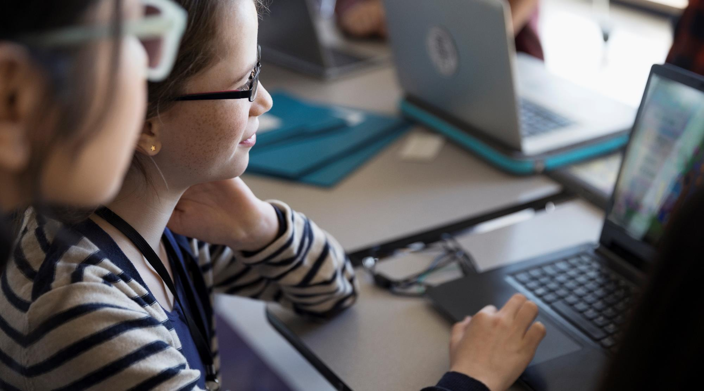
E-Commerce Web Application: Friend’s Spy
FULL STACK PROJECT II
Aman Kushwaha, Aman Saxena, Akarshit
Section : 3A, 3G
Project Type: Dynamic MERN Web Application
A new way to engage with Prople from across the globe.

Slide 2
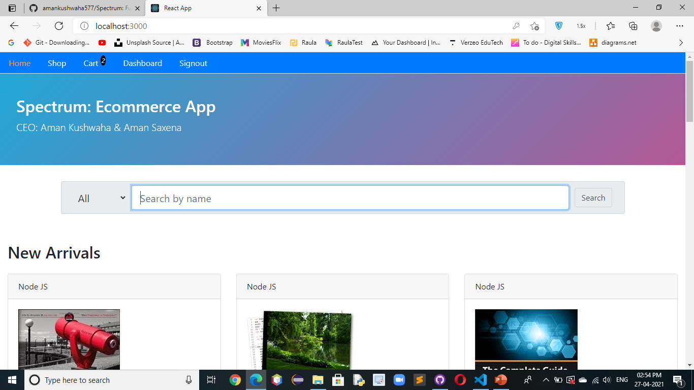
Introduction
It is not unusual for customers to travel long distances to reach their preferred physical store. E-commerce allows them to visit the same store virtually, with just a few mouse clicks.
Our Web App allows users to discover stories regarding post content they enjoy consuming, or simply communicate with friends.
Target millions of potential users to use and engage with our app.

Slide 3



PROBLEM STATEMENT AND SOLUTION
Problem 1
Problem 2
Problem 3
So far there is still need of efficient E-commerce website.
Unavailability of simplicity through which one can communicate.
There is an overhead of traffic in net that making chaotic situation and long time to access.

Slide 4
Front End and Back End Framework:
This Website have 7 Front End Web Pages ,And 9 BackEnd Web Pages.
HTML 5 and CSS 3
BOOTSRAP 4 and JS
MERN
Major Portion of this Web Application covered through React JS.
HTML 5 Used- 15%
For Media Query And Website Responiveness I have used CSS 3.
CSS 3 Used – 30%
For Effects and Premade library of css classes this website uses Bootstrap and css.
Bootstrap and css used -15%
MongoDB
Express
React
Node

Slide 5
Hardware And Software Requirement
Software Requirement
Hardware Requirement
Windows 8.1 OS and above
Visual Studio Code
Web Browser
Github Desktop
Laptop/Desktop
​1.8 GHz or faster processor. Quad-core or better recommended
​ 4 GB of RAM and core i3 processor
​Hard disk space: Minimum of 500MB

Slide 6
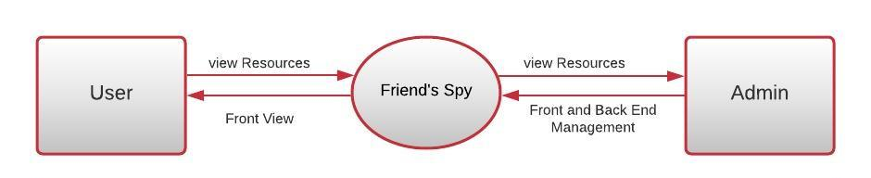
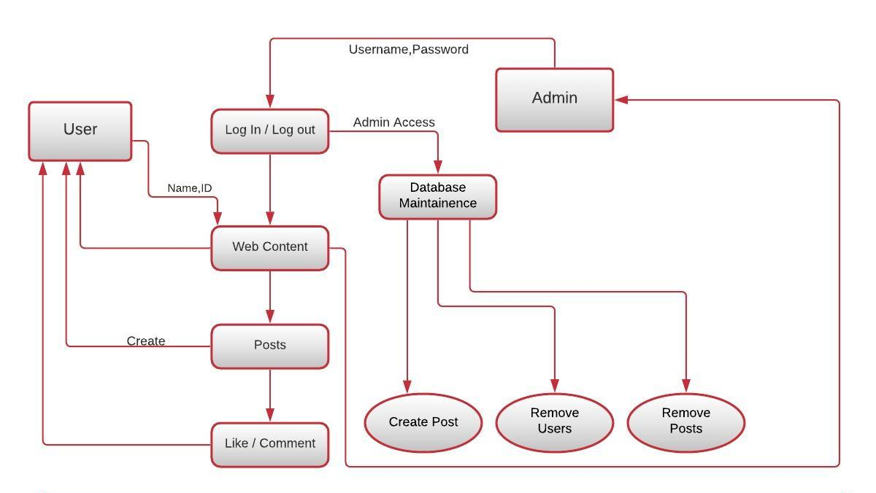
SPECTRUM
DFD Level Zero + Level One

Slide 7
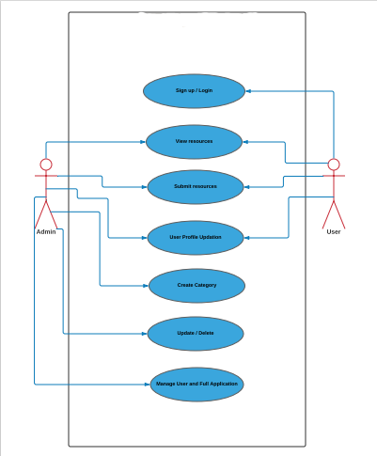
Usecase Diagram

Slide 8
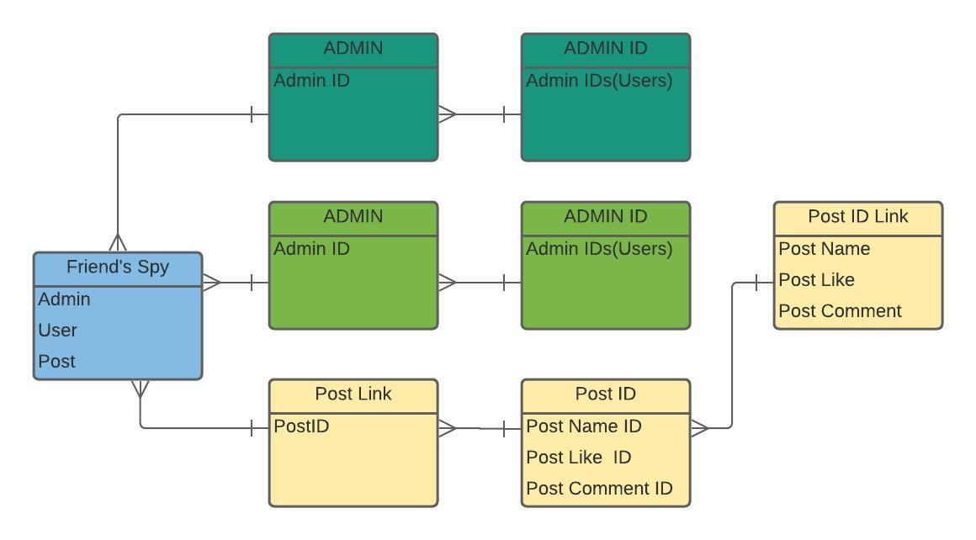
SPECTRUM
JSON DB

Slide 9
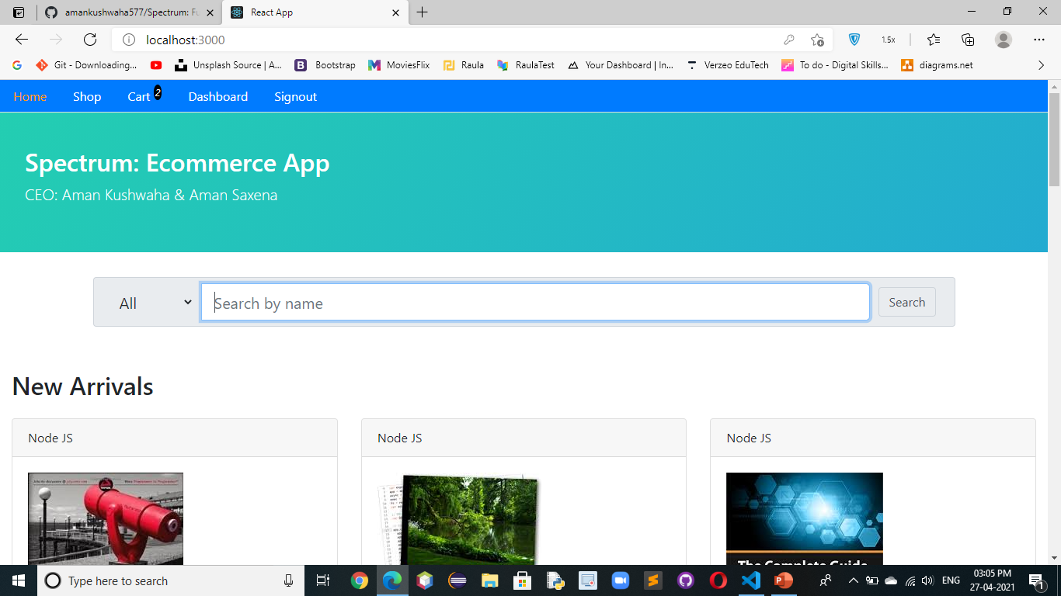
Home Page

Slide 10
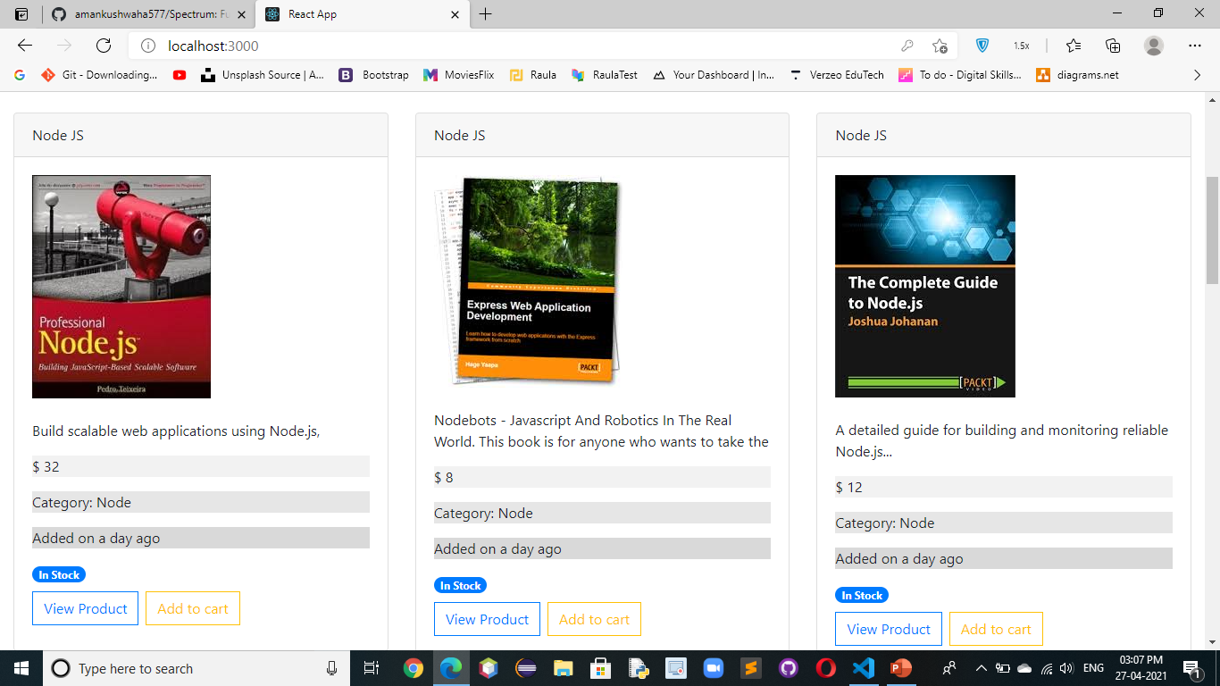
Section Divider
Home Page For All Uploaded Posts

Slide 11
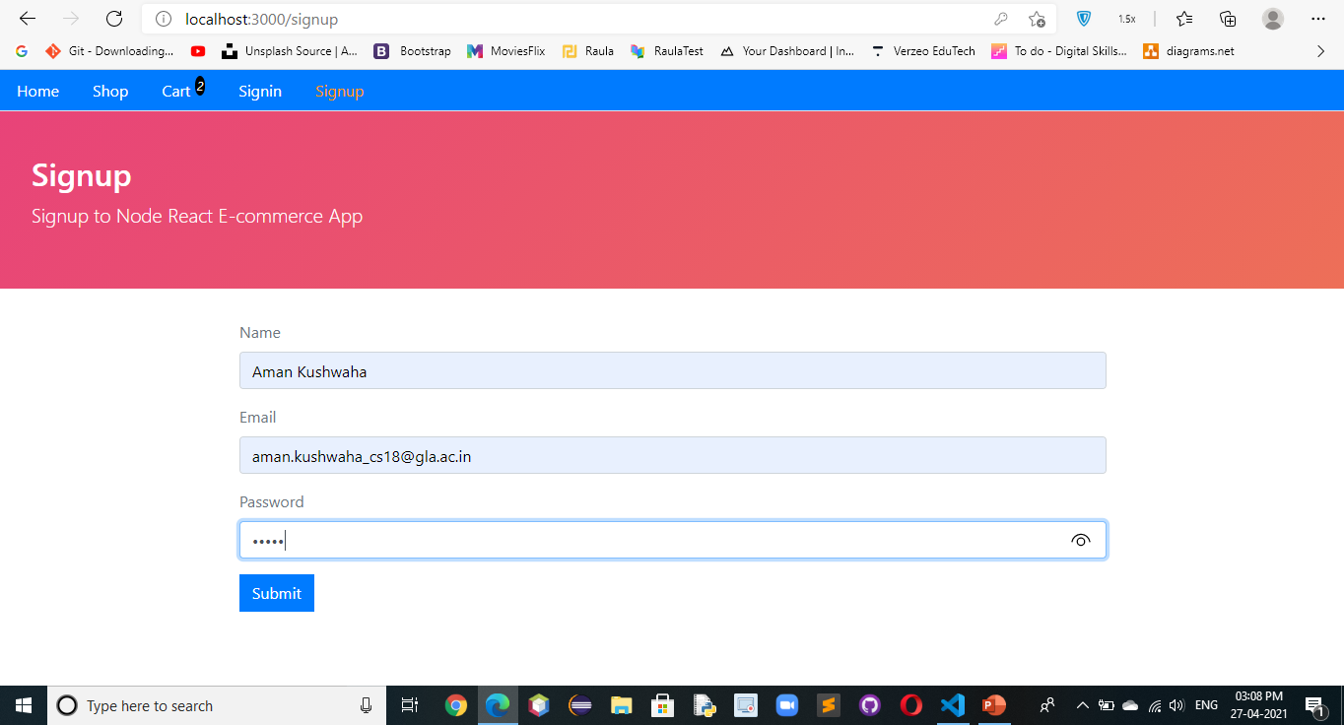
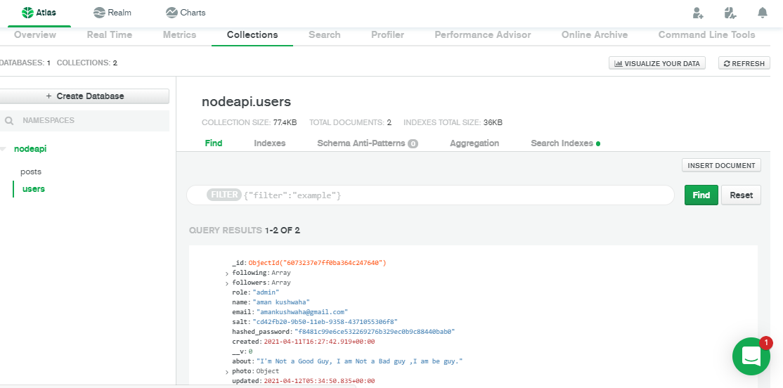
Sign Up

Slide 12
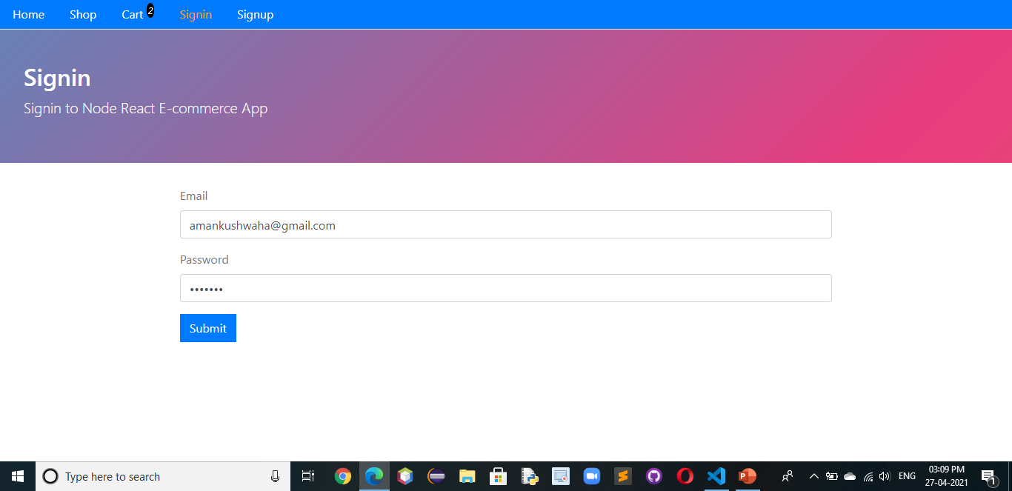
Sign IN(Admin or Client Authorization )

Slide 13
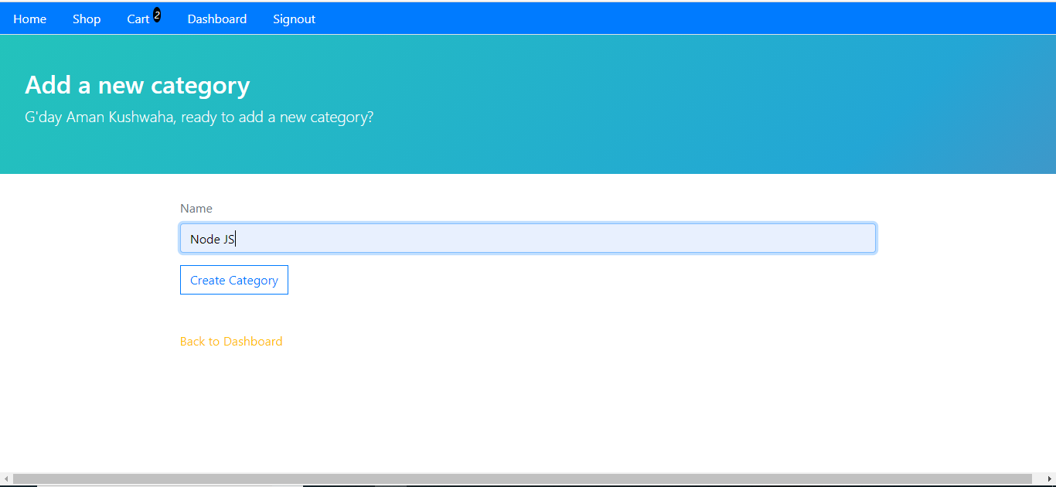
Create Post

Slide 14
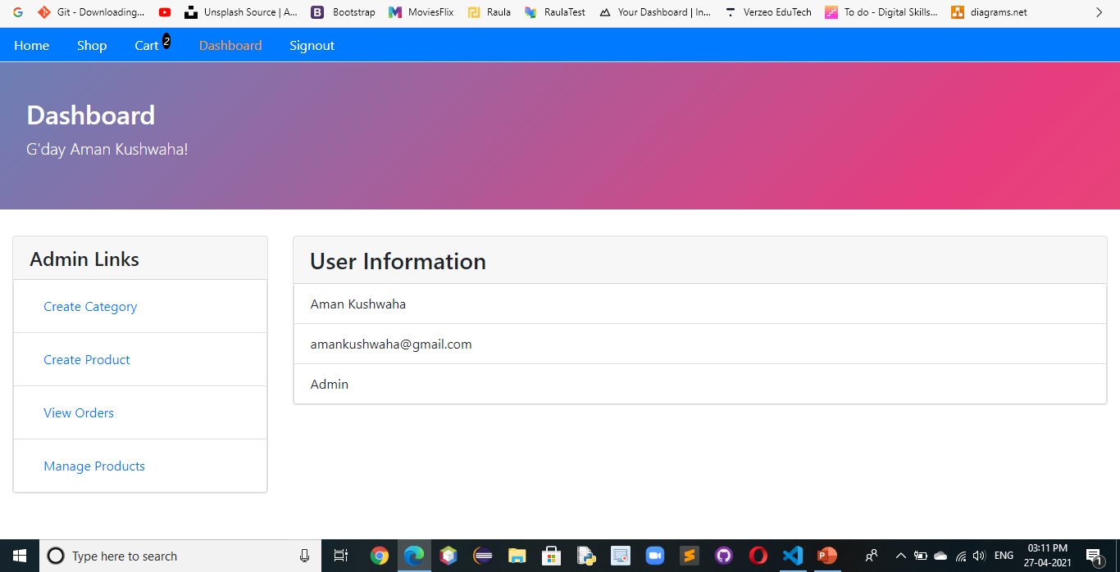
Admin Dashboard

Slide 15
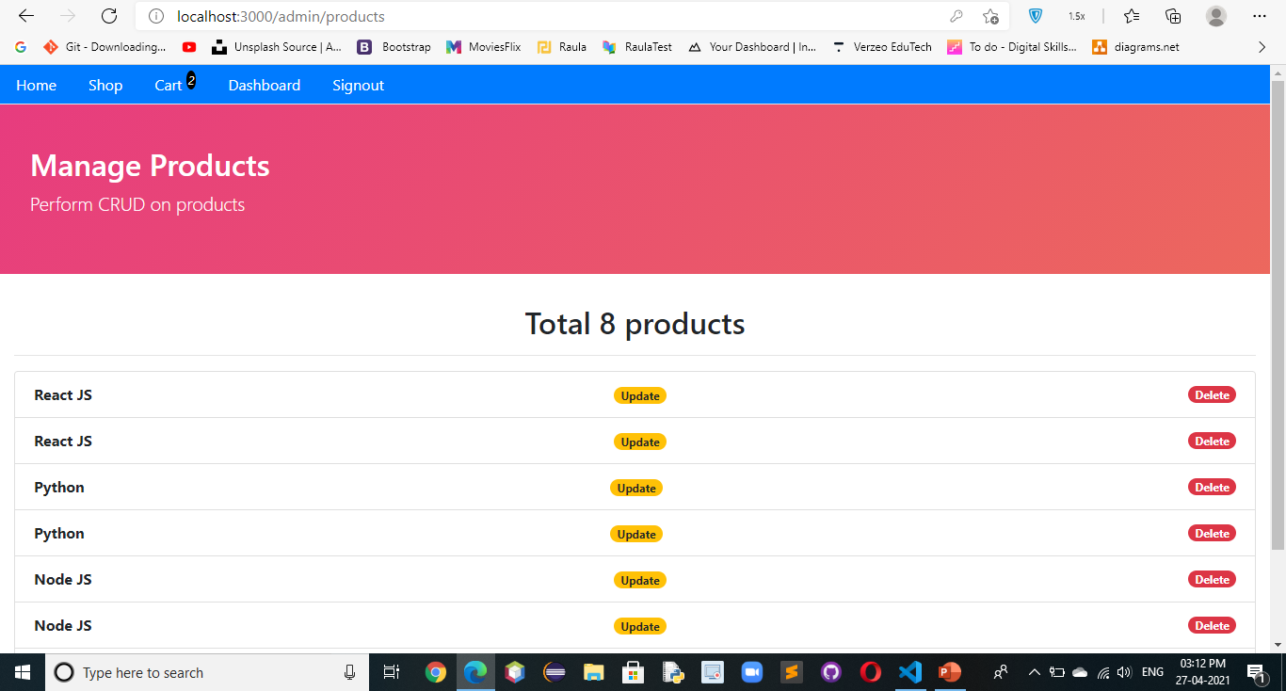
Edit/Update/Delete Post + Update/ Delete Users By Admin

Slide 16
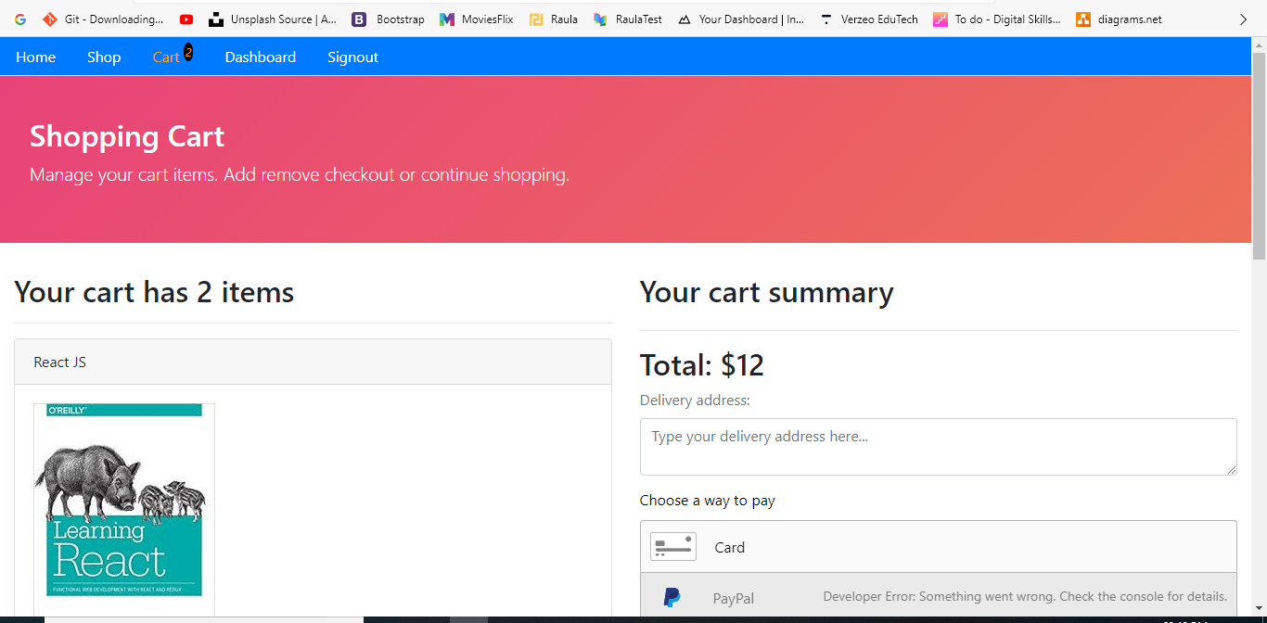
Shopping Kart

Slide 17
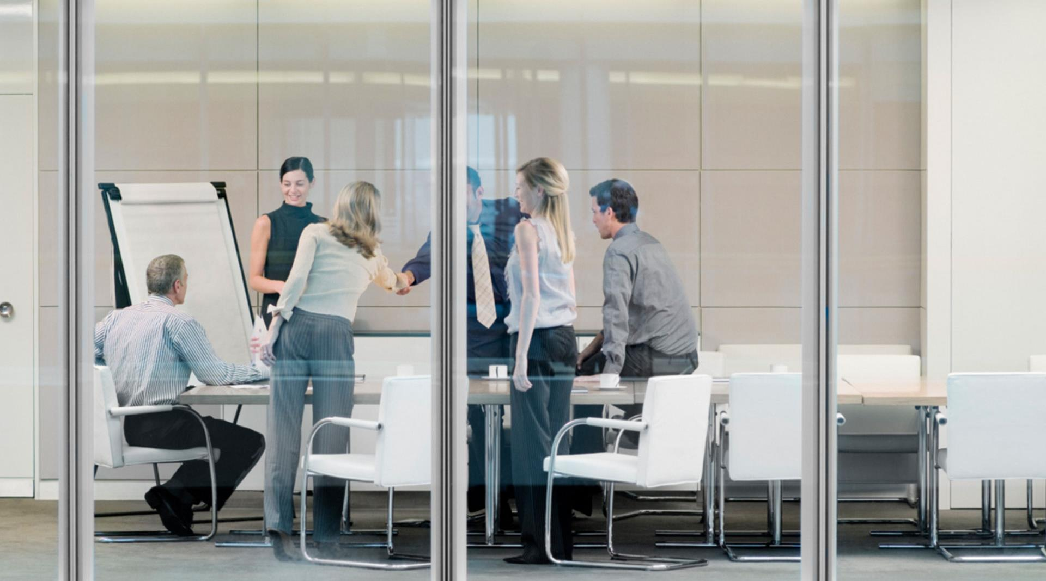

Thank You
Team Spectrum
Aman Kushwaha

